Slide 1
A Cooperative Database System (CoBase) for Query Relaxation
Wesley W. Chu, Hua Yang, and Gladys Chow
Presented by David Liu

Slide 2
Motivation
Often times when you query, you want ‘about the same’ instead of ‘exactly’
  Medical Image Diagnosis—match images to diseases
Other times, you might not even want near items, just the least far
  ARPA/Rome Planning Labs Initiative (ARPI) Transportation problem

Slide 3
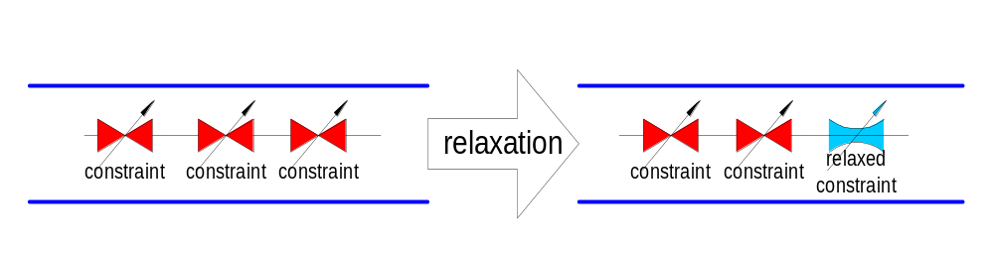
High Level description of solution
View a query Q’s response set R as a subset of all information stored in the database
All records in R satisfy a set of constraints C put forth by Q
If R is empty, then perform incremental relaxation

Slide 4
CoBase
Main design features:
  Relaxation: if there’s no exact match, try to find a ‘close’ neighbor and see if he matches
  Control: allow the user to control relaxations
  Explanation: justify relaxations to the user in semantic terms

Slide 5
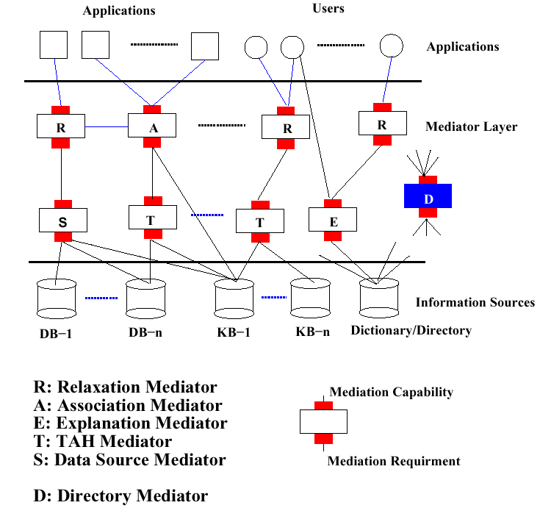
Architecture
Source: A Cooperative Database System for Query Relaxation, page 4

Slide 6
Demonstration

Slide 7
Relaxation: Type Abstraction Hierarchies
Sample query:
SELECT *
FROM Students s
WHERE s.GPA = 3.700
Suppose that there are no students with GPA = 3.700, but some with 3.682 and another with 3.702
We might conceptually have wanted the student table to return these tuples
We can use Type Abstraction Hierarchies (TAHs) to classify GPA’s conceptually

Slide 8
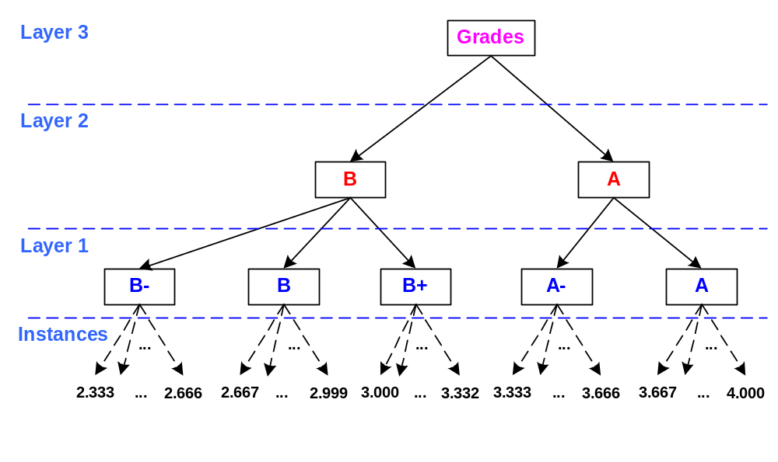
Relaxation:
Type Abstraction Hierarchy(TAH)

Slide 9
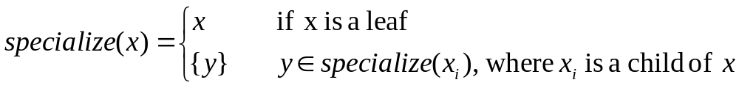
TAH Operators
There are two special operators used to exploit the TAH:
  Generalize(node x)—get the parent of x, which which encapsulates instances which are similar to x
  Specialize(node x)—get the set of all instances represented by node x. Definition:
  Note: these two operators not inverses

Slide 10
TAH Operators
A relaxation can be seen as:
  Specialize(Generalize(x)): where x is the value/predicate that we are trying to relax
An n-level relaxation is then:
  Specialize(Generalize^{n}(x)): which is the same as n iterative generalizations followed by a specialization

Slide 11
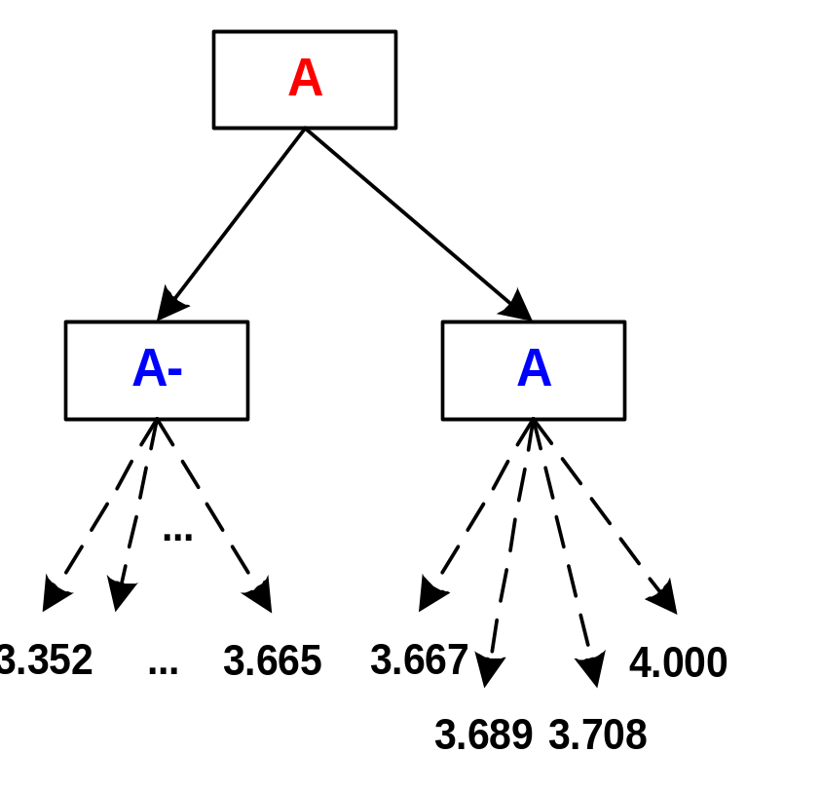
Relaxation Example
Example: subtree of the GPA TAH:
  Generalize(3.700) will yield node A
  Specialize(Generalize(3.700)) will yield the set of values: {3.667,…,4.000}
  Specialize(Generalize²(3.700)) will yield the following set:
  {3.352,…,3.700,…,4.000}

Slide 12
Multi-attribute Type Abstraction Hierarchy (MTAH)
MTAH’s are multiple-attribute type abstraction hierarchies
These are a generalization of single-attribute TAH’s
MTAH’s can be used to classify geographical data

Slide 13
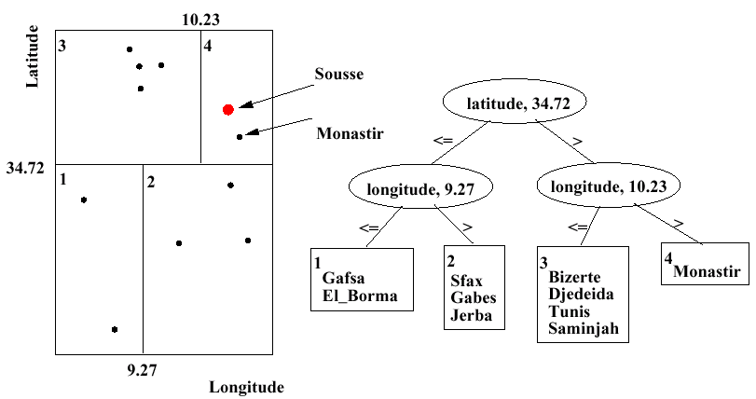
MTAHs: Example
Bizerte
Djedeida
Tunis
Saminjah
Sfax
Gafsa
Jerba
Gabes
El_Borma
Based on: A Cooperative Database System for Query Relaxation, page 6

Slide 14
Automatic Generation of TAH’s
Main idea:
  recursively partition search space into two until each partition has less than T items
  Repartition each partition further to obtain N-ary partition. This is done with a hill climbing algorithm

Slide 15
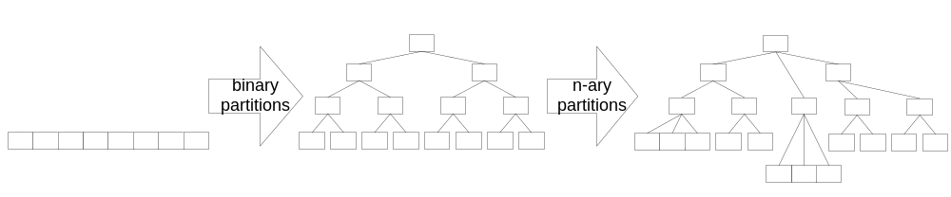
Automatic Generation of TAH’s
Main idea:
  Binary partitioning: recursively partition search space into two until each partition has less than T items
  N-ary partitioning: Repartition each partition further to obtain N-ary partition. This is done with a hill climbing algorithm

Slide 16
Automatic Generation of TAH’s
After each partition, calculate the Categorical Utility of the partitioning to decide whether to terminate
Relaxation Errors to measure utility

Slide 17
Generation of TAH’s complexity
In general, partitioning is exponential: O(N^{N}) where N is the number of items
Partitioning a sorted set into contiguous clusters allows O(n²) worst-case performance and O(n log n) average performance

Slide 18
CoSQL
Extension to SQL to add relaxation operators
  Context Free
  Context Sensitive
  Control
  Interactive

Slide 19
CoSQL: Context Free
Approximate
  ^v₁
  Return values approximate to v₁
Between two members
  between(v₁,v₂)
  Return values between two values
Within a set
  Within(v₁,v₂,…,v_{n})
  Specifies set membership

Slide 20
CoSQL: Context Sensitive
Context sensitive nearness
  Near-to X
User-specified nearness
  Similar to X based-on ((a₁ w₁) (a₂ w₂)…(a_{n} w_{n})
  a_{i} are attributes and w_{i} are weights

Slide 21
CoSQL: Control Operators
Prioritization of relaxation
  Relaxation-order(a₁,a₂,…,a_{n})
Relaxation restriction
  Not-relaxable(a₁,a₂,…,a_{n})
Preference-list
  Preference-list(v₁,v₂,…,v_{n}) on a particular attribute a
Unacceptable values
  Unacceptable-list(v₁,v₂,…,v_{n}) on a particular attribute a

Slide 22
CoSQL: Control Operators cont’d
Using another TAH
  Alternative-TAH(TAH-Name)
Restricting amount of relaxation
  Relaxation-level(v)
Answer-set(s)
  Specifies the minimum set of answers

Slide 23
CoSQL: Interactive operators
Nearer, further
  These Interactive operators are invoked after the user see’s an answer-set
  not SQL per se
  Used to interactively control geographical queries

Slide 24
Explanation Mediators
By having automated relaxation, the user loses understanding of the system
Explanation mediator explains relaxations and justifies them to the user
Explanations come from an explanation dictionary

Slide 25
Performance
Queries from the ARPI transportation domain had the following results:
  Query relaxation time 1/5 (2 secs) of database retrieval time
  Database retrieval time (10 secs)
  Explanation time also another 1/5 (2 secs) of database retrieval time
  Total overhead is about 40%
  Most important measure: relaxation quality, is difficult to measure
  Unclear: exact running times of TAH generation and storage spaces for these TAH’s

Slide 26
TAH’s and B-trees?
TAH’s are much like B-tree indexes:
  Hierarchical
  Cluster-based
  Partition search space
  TAH:B-tree::MTAH:R-tree
    With the exception that R-trees allow overlapping partitions
  TAH like iterative access method that traverses up and down the tree

Slide 27
Applications
Medical Image matching
ARPI Transportation Planning
Electronic Warfare

Slide 28
Evaluation
Mutually exclusive partitioning could be a problem
  Optimal arrangement for this CoBase’s relaxation approach is to radiate outward from the querying ‘epicenter’
Multiple dimension exacerbates the partitioning problem
Indexing techniques might be beneficial to allow overlapping partitions

Slide 29
The End

Slide 30
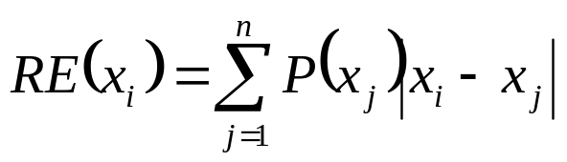
Categorical Utility(CU)
Categorical Utility is the objective value of a partition
RE of a point:
  X_{i} is a point, P(x_{j})=probability of point x_{j}

Slide 31
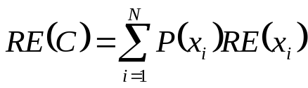
Categorical Utility(CU)
Categorical Utility is the objective value of a partition
RE of a partition:
  C is a partition, x_{i}’s are the points in the partition, P(x_{i}) is the probability of occurrence of each point, RE(x_{i}) is the relaxation error of the point in the partition

Slide 32
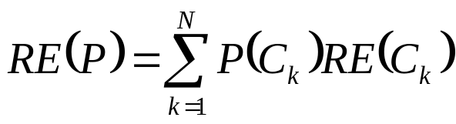
Categorical Utility(CU)
Categorical Utility is the objective value of a partition
RE of a partition:
  P is a partitioning, P(C_{k}) is the probability of occurrence of each partition, RE(C_{k}) is the relaxation error of the partition

